Slide 1

Tweets About TESLA Stock
Sabrina Yang

Slide 2
1.
Introduction

Slide 3
STOCK MARKET & SOCIAL MEDIA MOODS
GameStop
Meme stock & coin
Stonk only goes up

Slide 4
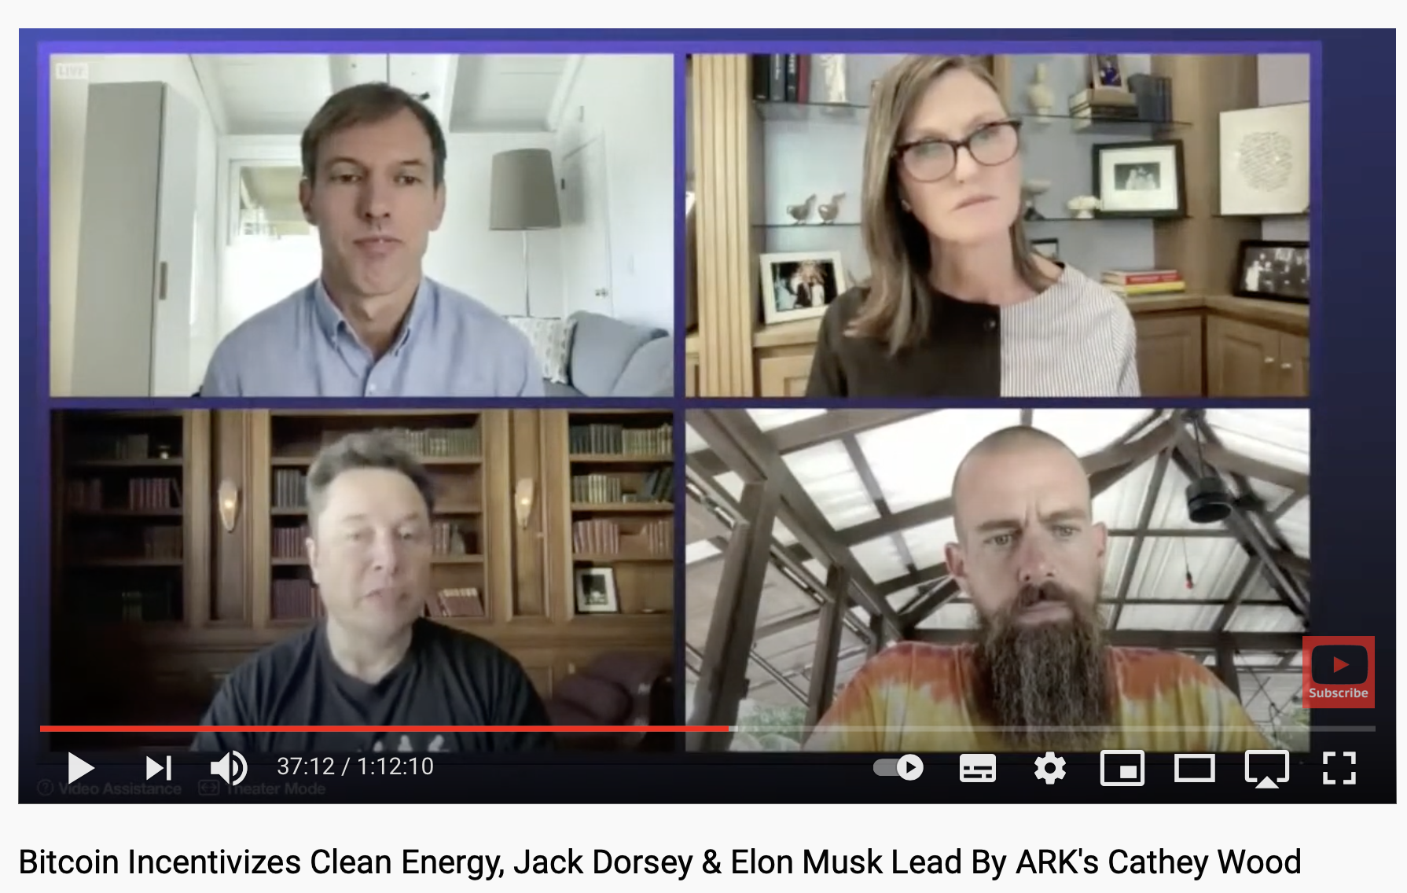

Slide 5
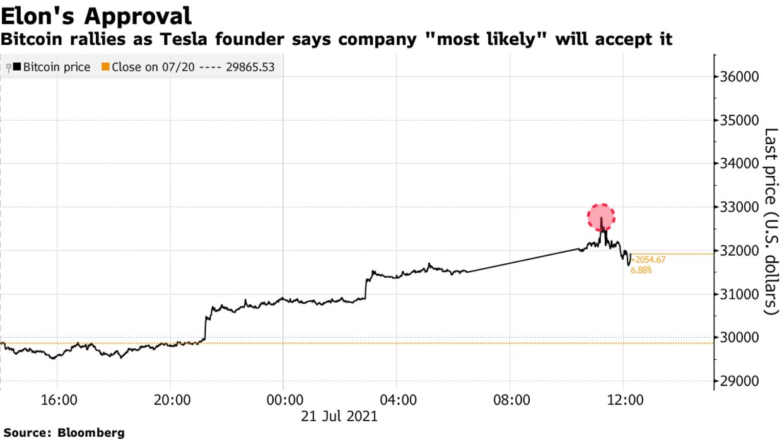

Slide 6

Twitter Mood 😋😒
Go-to info platform for Elite Investors, Institutions & Retail traders
Behavioral science
Notes:
Social media, including Twitter, have become go-to information platforms for elite investors, from hedge fund billionaire Ray Dalio to Chima
Personal financial planners are all over Twitter, too, and they say the investing education available for free can equal learning from a postgraduate degree.
. Behavioral finance has provided further proof that financial decisions are significantly driven by emotion and mood. It is therefore reasonable to assume that the public mood and sentiment can drive stock market values as much as news. As far as tweets go, some interesting discoveries have already been made. I also wanted to investigate this, and made some interesting discoveries!

Slide 7
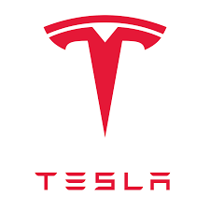
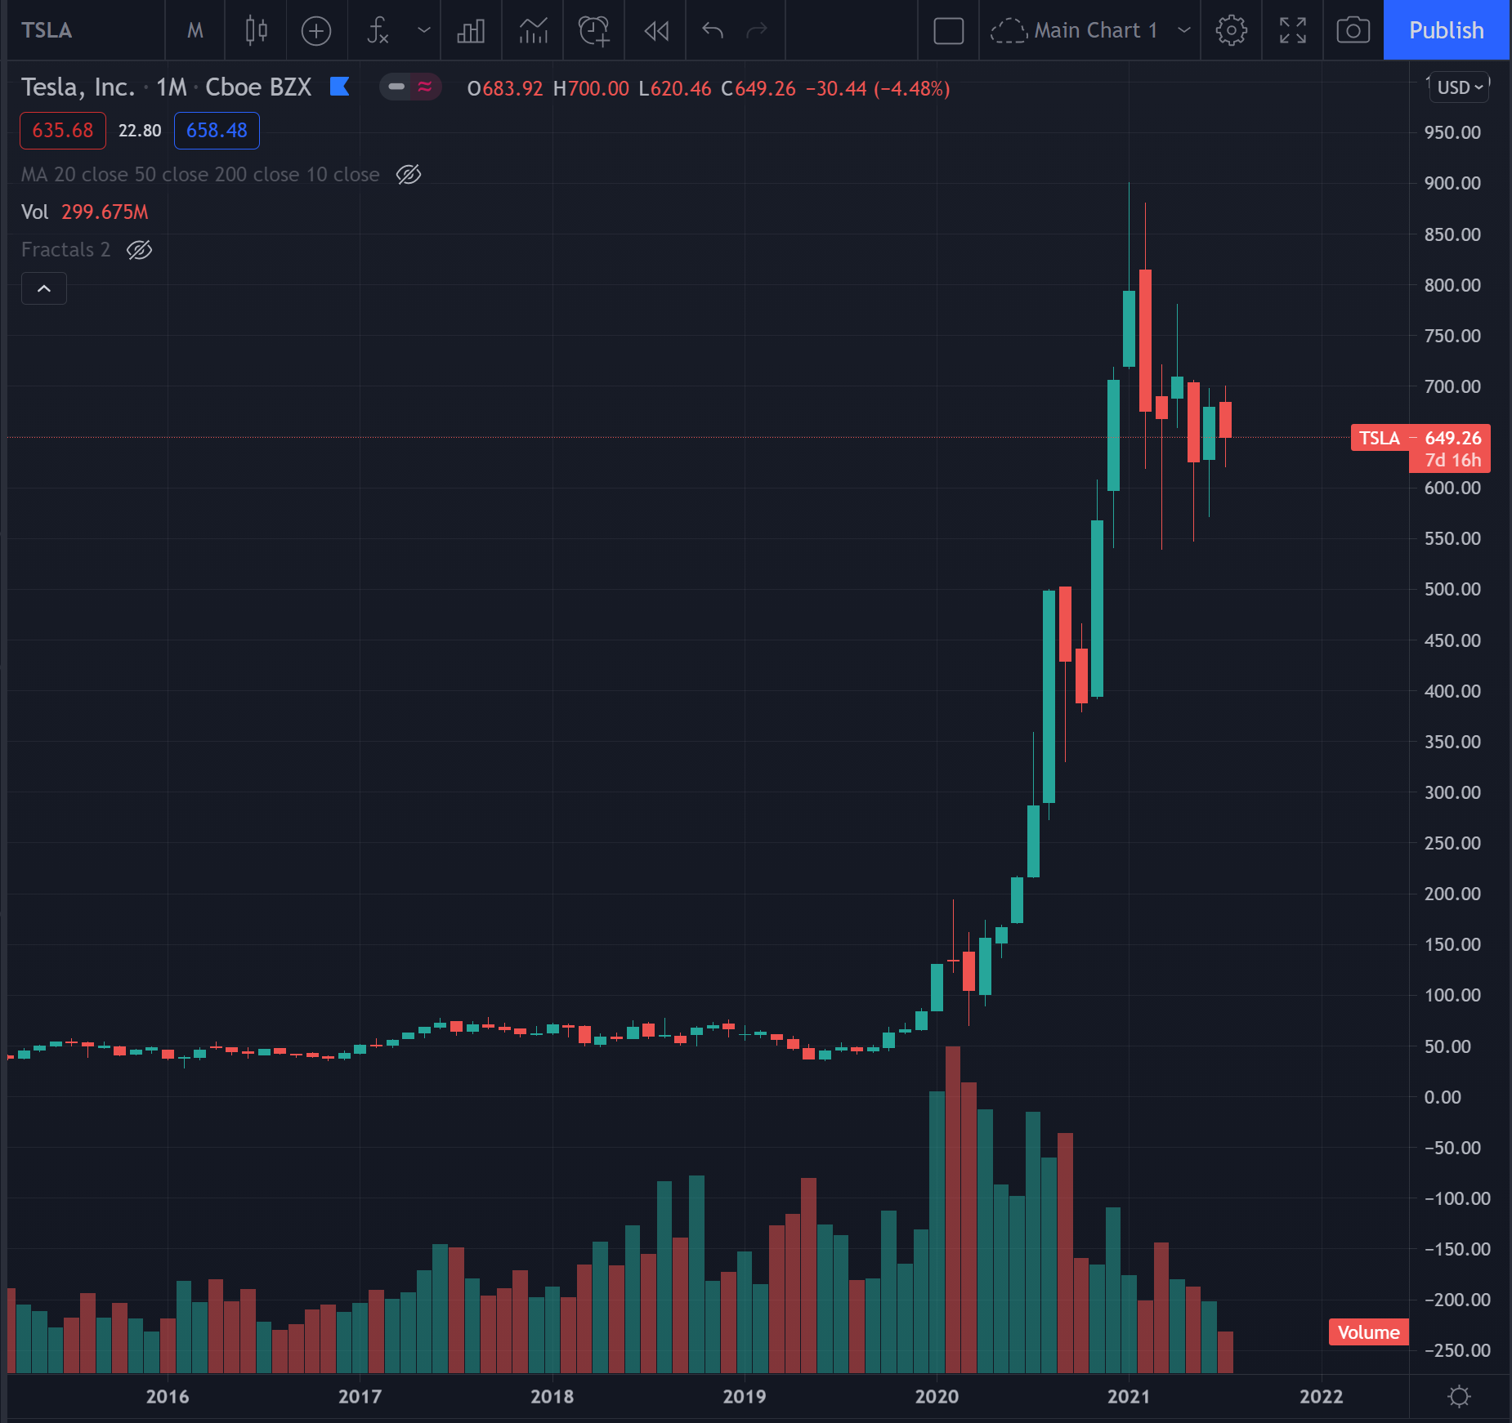
Tesla
Highest volume traded stock
Elon Musk constantly in the spotlight
Extremely high stock appreciation and volatility

Slide 8
2.
Data

Slide 9
DATA GATHERING
Twitter Tweets
API Tweepy
07/11 – 07/19 Daily 2000 tweets
Total 18019 tweets -> 9500 tweets
Tesla Stock Price
Yahoo Finance
Pandas web.DataReader
short term only

Slide 10
3.
Approach
NLP & Unsupervised Learning

Slide 11
NLP ROADMAP
Text preprocessing
TFIDF
stopwords
Filter out noise
+ NMF
1
3
5
2
4
6
NMF
Topic Modeling
Stem
Tokenizer
NLTK Vader
Sentiment Analysis

Slide 12
MODELING WORKFLOW
15 TOPICS
NMF (n_components=15)
FILTER OUT NOISE
Chatroom Ads, DAILY ALERTS, Discord, Sign up
8 TOPICS
NMF (n_components=8)
TOPIC
Interpretation
Interpretation for meta data
SENTIMENT
NLTK Vader Compound Score
CLUSTER
Kmeans clustering (unsupervised learning)
Plot by TSNE
Notes:
Tweet/Word Matrix - tfidf
Tweet/Topic Matrix – NMF
Word/Topic Martix - nmf.components_

Slide 13
4.
Results
Topics & Sentiment

Slide 14
$TSLA TOPICS
Fear
FSD Subscription Ownership
technical analysis
price charts
CEO activities
personal trading ideas
FUD
BITCOIN
CAR
#FINTWIT
STOCK
MEME STOCK
JUL
ELON MUSK
RETAIL
TRADING IDEAS
how much Tesla made from bitcoin investment
Connect to Reddit
#wallstreetbet
influencers account promoting certain stocks (AMC, GME)
opinions and feelings

Slide 15
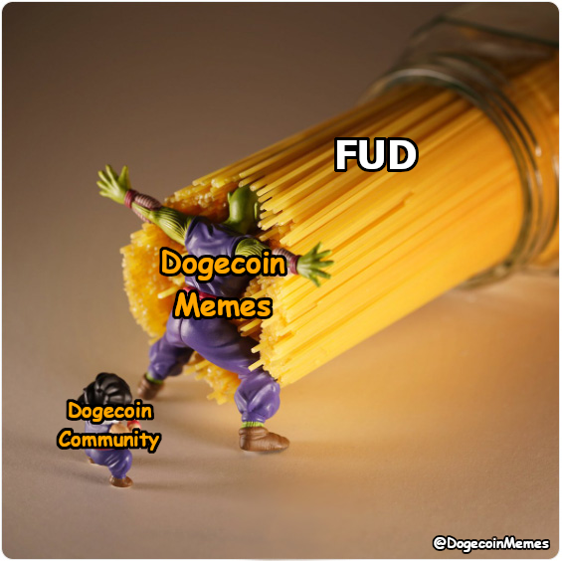
TOPIC FUD
Fear
Uncertainty
Doubt

Slide 16
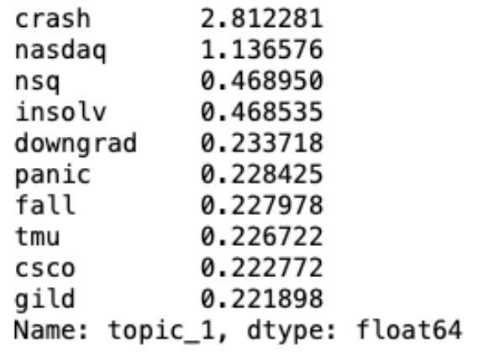
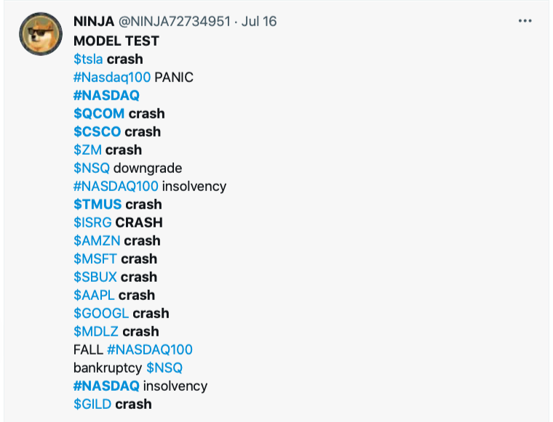
TOPIC FUD
Top words
Representative tweet

Slide 17
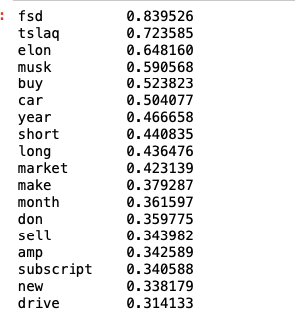
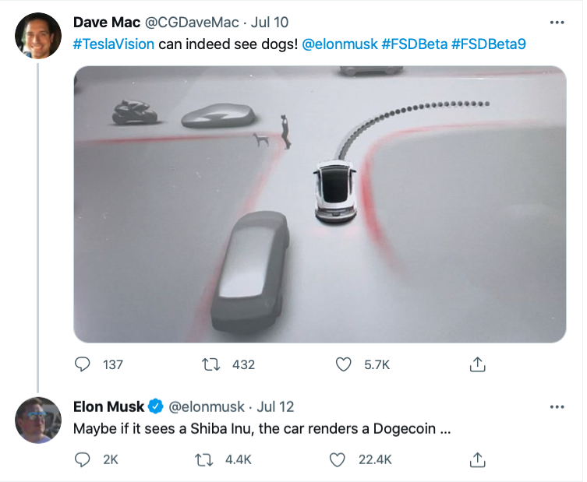
TOPIC Elon Musk + Car
Top words
Representative tweet
short > long

Slide 18
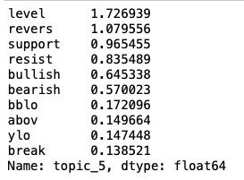
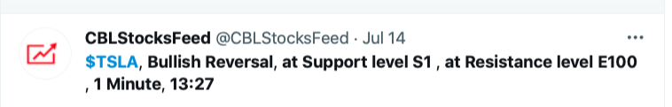
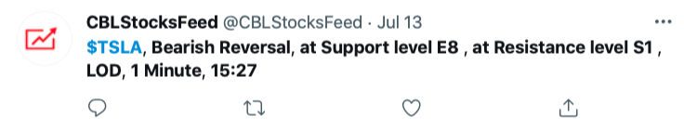
TOPIC Technical Analysis
Top words
Representative tweet

Slide 19
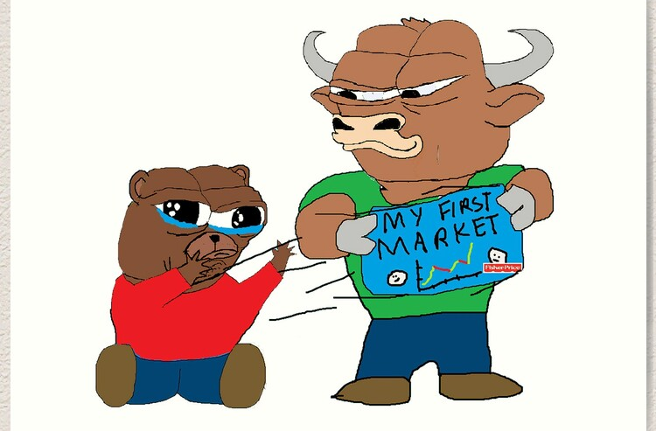
Bulls or Bears?
Short term observation
sentiment & market

Slide 20
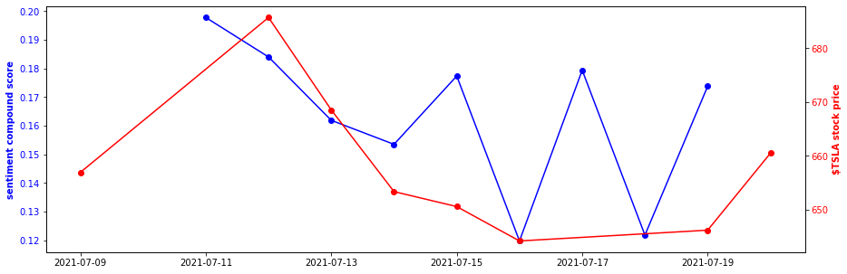
SENTIMENT vs STOCK PRICE
$TSLA No perfect correlations but some interesting patterns

Slide 21
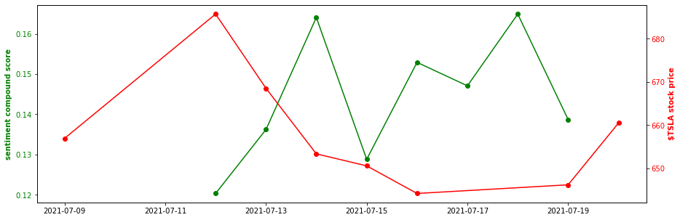
SENTIMENT vs STOCK PRICE
Tesla less correlations

Slide 22
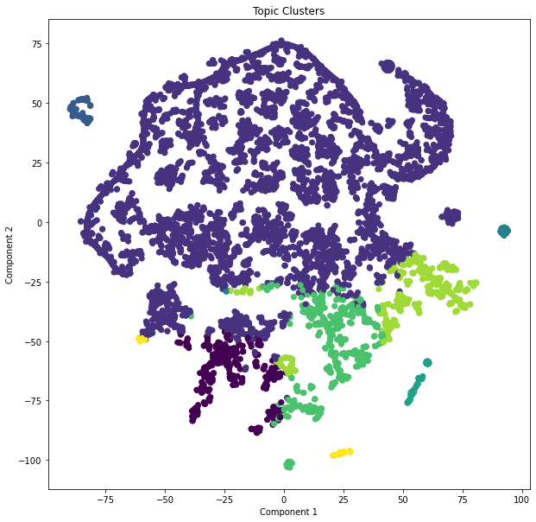
Kmeans Clustering
NMF output
8 topics
Kmeans Cluster
elbow method
k = 8
T-SNE dimensions reduction
high dimensions -> 2

Slide 23
4.
Future Work

Slide 24




More Tweets & Diversified Resources
Tweets timeframe - Longer period of 1 year+
Retweets power times
Elon Musk’s tweets
Resources:
Related market:

Slide 25
THANKS!
Any questions?

Slide 26
Appendix
EDA & Topic modeling

Slide 27
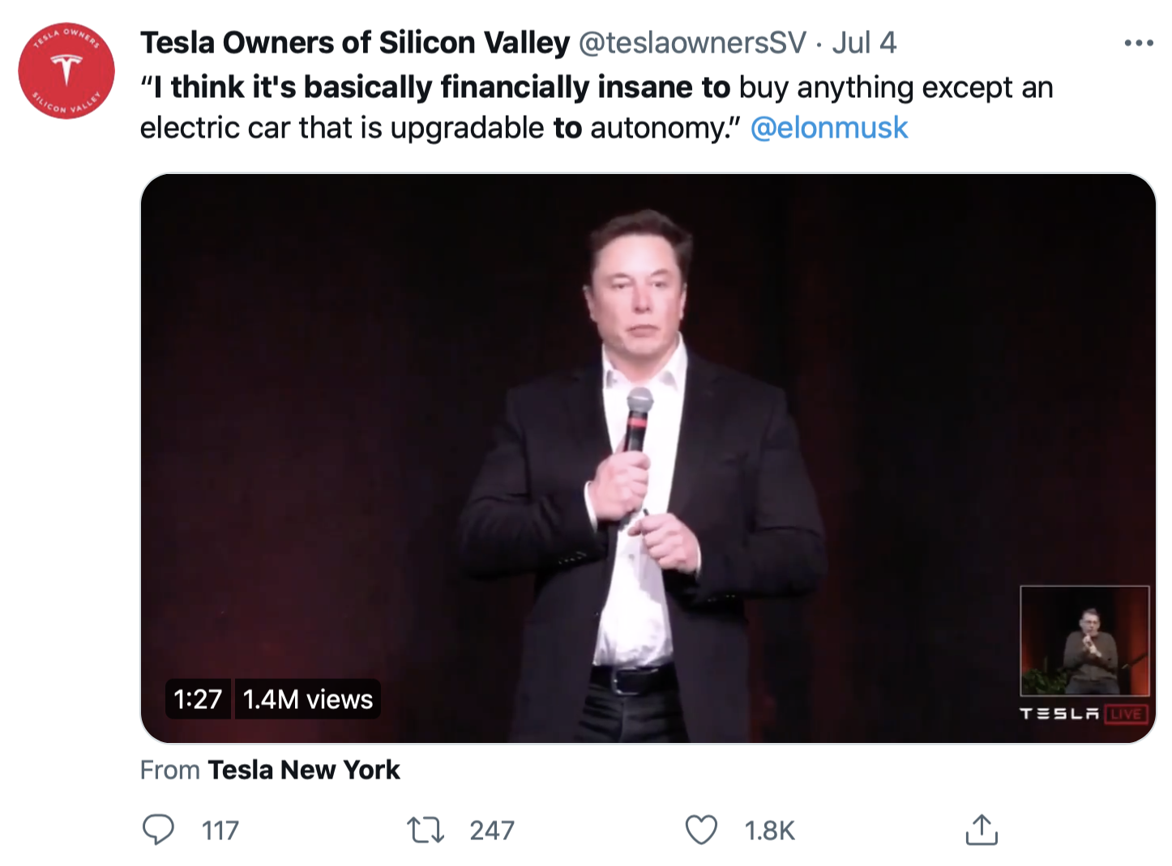
TWEETS RETWEETS
Dated tweet that was retweeted 1747x
Notes:
One of the tweets was actually retweeted 1747 times and it was actually a really old one that you can see on the right side.

Slide 28
TWEETS HASHTAGS
144x
#Tesla
100x
#Fintwits, #Investing, #Stocks, #Wallstreetbets
97x
#Options, #OptionsTrading, #OptionsFlow, #Stocks, #StockMarket, #Investment, #Investing, #Investors, #UOA
28
Notes:
The combination comes up so many times, so I suspect there’s some spams and advertisements

Slide 29
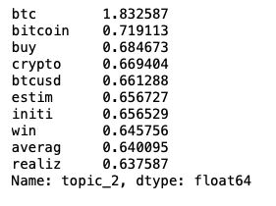
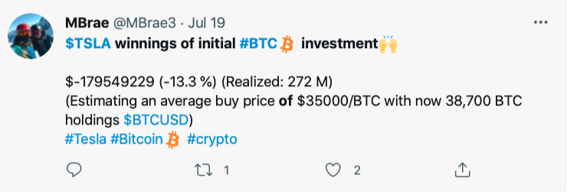
TOPIC BITCOIN
Top words
Representative tweet
Notes:
Fake news ????

Slide 30
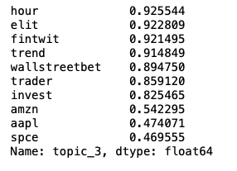
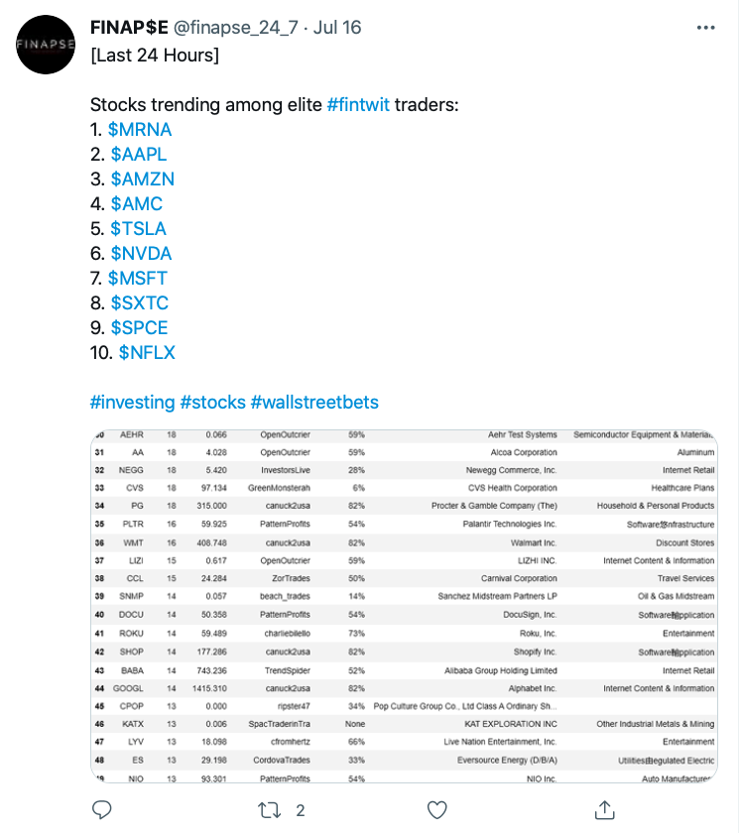
TOPIC FINTWIT
Top words
Representative tweet
Notes:
Fake news ????

Slide 31
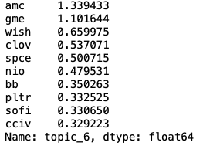
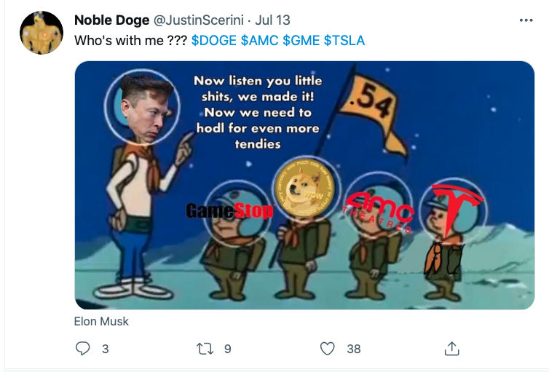
TOPIC MEMESTOCK
Top words
Representative tweet

